Slide 1




Project: Analyzing the Impact of Car Features on Price and Profitability
Divyasri Jegan
D

Slide 2
Project Description :
The automotive industry has been rapidly evolving over the past few decades, with a growing focus on fuel efficiency, environmental sustainability, and technological innovation. With increasing competition among manufacturers and a changing consumer landscape, it has become more important than ever to understand the factors that drive consumer demand for cars.
In recent years, there has been a growing trend towards electric and hybrid vehicles and increased interest in alternative fuel sources such as hydrogen and natural gas. At the same time, traditional gasoline-powered cars remain dominant in the market, with varying fuel types and grades available to consumers.
The client has asked How can a car manufacturer optimize pricing and product development decisions to maximize profitability while meeting consumer demand?
As a Data Analyst., this problem could be approached by analyzing the relationship between a car's features, market category, and pricing, and identifying which features and categories are most popular among consumers and most profitable for the manufacturer. By using data analysis techniques such as regression analysis and market segmentation, the manufacturer could develop a pricing strategy that balances consumer demand with profitability, and identify which product features to focus on in future product development efforts. This could help the manufacturer improve its competitiveness in the market and increase its profitability over time.

Slide 3

APPROACH
01
TECH STACK USED
02
DATA DESCRIPTION
03
DATA PREPROCESSING
04
INSIGHTS : ANALYSIS
05
DASHBOARD
06
CONCLUSION
07
LINKS

Slide 4




TECH STACK USED
GOOGLE SHEETS FOR EXCELING :
The dataset is being processing using this tech stack which demands on providing detailed data processing and to make interactive dashboards.
GOOGLE SLIDES :
For the presentation of the project and to enhance the details of project ,helps in describing of works.

Slide 5





DATA DESCRIPTION
The dataset provides details about the various car features like the Company, Year of Manufacture, Engine Type and Power etc.
mNNO OF DATA POINTS :
NUMBER OF FEATURES :
COLUMNS:
The dataset contains a data
points of 11,914 as it has
a variety of datas.
The dataset of car imports as
attributes that is the features
of car involving style, look and so on.
Car dataset involves columns like manufacturer, Company, Year, Price, etc…..
DATASET : Car_Dataset

Slide 6



DATA PREPROCESSING
Mission
The mission of the project is to provide the client about the car impacts of car on price and profitability.
This can be done by analysis of dataset to check for null data and process them in order to provide a valid result to the clients.
Performing handling of data and handling error is significant.
Vision
As a Data Analyst, this problem could be approached by analyzing the relationship between a car’s features, market category and pricing.
By regression and market segmentation to make a strategy for manufacturer to make better future decisions.
This could help the manufacturer improve its competitiveness in the market and increase its profitability over time.

Slide 7
INSIGHTS : ANALYSIS
The given tasks below based on the business problem would require advanced Excel skills and knowledge of data analysis techniques such as regression analysis, pivot tables, sensitivity analysis, optimization, and time series analysis.

Slide 8

01
02
03
04
04
05
TASK 1
TASK 2
TASK 3
TASK 4
TASK 5
How does the popularity
of a car model vary
across different market categories?
What is relationship between a car's
engine power and
its price?
Which car features are most important in determining a car's
price?
How does the average price of a car vary
across different manufacturers?
What is the relationship between fuel efficiency and the number of cylinders in a car's engine?

Slide 9

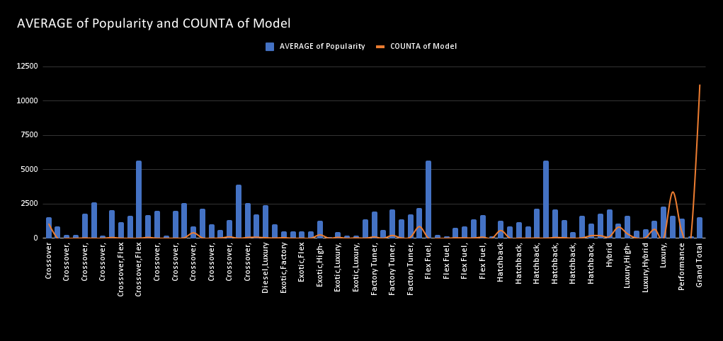
TASK - 1
Insight Required: How does the popularity of a car model vary across different market categories?
Task 1.A: Create a pivot table that shows the number of car models in each market category and their corresponding popularity scores.
Task 1.B: Create a combo chart that visualizes the relationship between market category and popularity.
We can observe that the average popularity of cars based on their Market Category mainly ranges from 1200 to 1800 with the exception of Exotic cars being lowest and most popular.
The dataset has comparatively higher number of Performance and Luxury cars followed by Crossovers and Flex Fuel.
CUSTOMERS

Slide 10
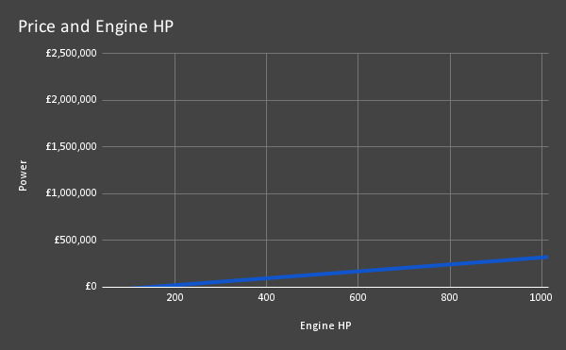
TASK - 2
Insight Required: What is the relationship between a car's engine power and its price?
Task 2: Create a scatter chart that plots engine power on the x-axis and price on the y-axis. Add a trendline to the chart to visualize the relationship between these variables.
cars.We can observe that the relationship is positive as the trendline has positive slope. This is logical as higher Engine HP requires more complex level of design and engineering and more expensive sub-parts. Also cars with higher Engine HP are mostly Performance
CUSTOMERS

Slide 11
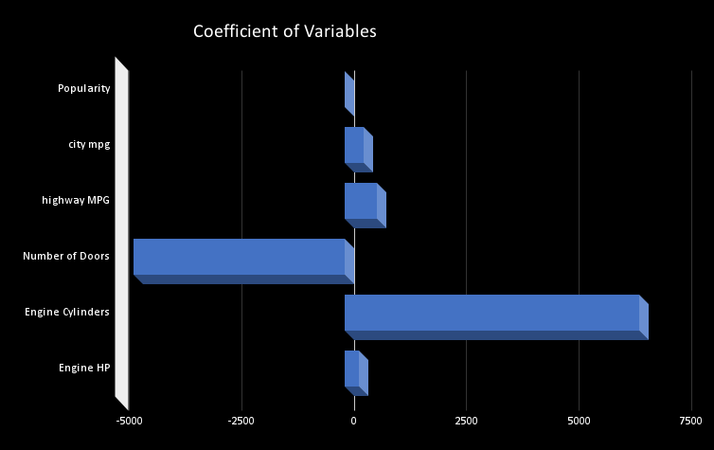
TASK - 3
Insight Required: Which car features are most important in determining a car's price?
Task 3: Use regression analysis to identify the variables that have the strongest relationship with a car's price. Then create a bar chart that shows the coefficient values for each variable to visualize their relative importance.
Using regression analysis, we found the top columns. This also include two new columns which were Feature Engineered (Engine HP/city mpg) and (1/(highway MPG + city mpg)).
We can observe that the R-Squared score is 0.7 which can be counted as a good score
.We can observe that the highest coefficient value is that of Engineered Feature, 1/(highway MPG + city mpg).
This shows that the Engineered Feature is very important relationship with Car’s price.
CUSTOMERS

Slide 12
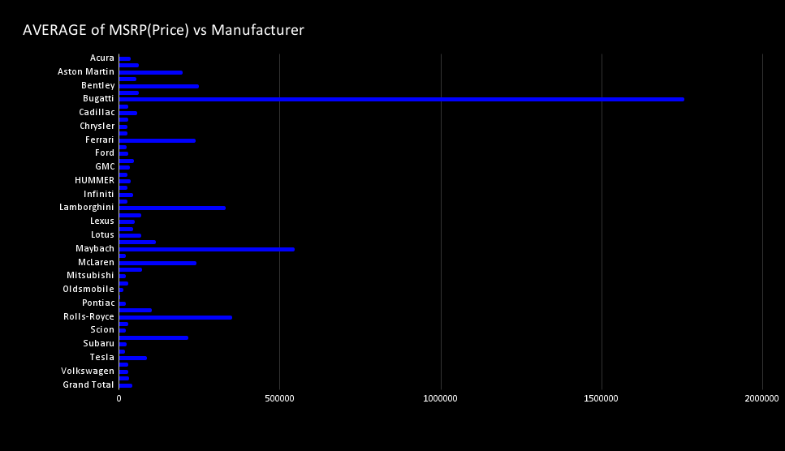
TASK - 4
Insight Required: How does the average price of a car vary across different manufacturers?
Task 4.A: Create a pivot table that shows the average price of cars for each manufacturer.
Task 4.B: Create a bar chart or a horizontal stacked bar chart that visualizes the relationship between manufacturer and average price.
We can observe that the most expensive cars are that of Bugatti brand followed by Maybach, Rolls-Royce, Lamborghini etc. All these cars brands are High-Performance and Luxury brands.
CUSTOMERS

Slide 13
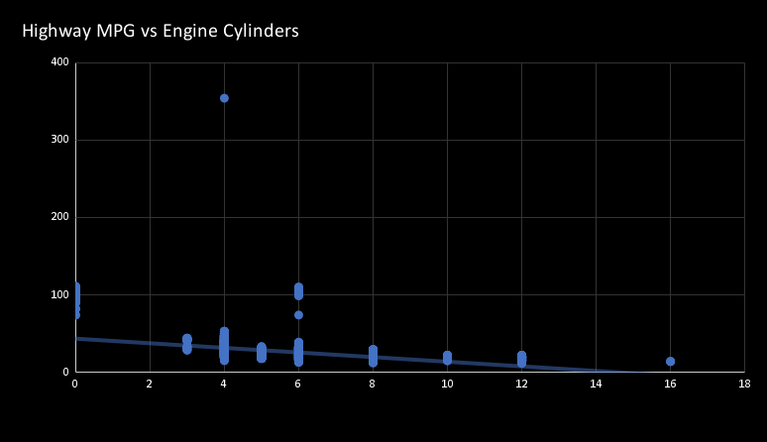
TASK - 5
Insight Required: What is the relationship between fuel efficiency and the number of cylinders in a car's engine?
Task 5.A: Create a scatter plot with the number of cylinders on the x-axis and highway MPG on the y-axis. Then create a trendline on the scatter plot to visually estimate the slope of the relationship and assess its significance.
Task 5.B: Calculate the correlation coefficient between the number of cylinders and highway MPG to quantify the strength and direction of the relationship.
We can observe that the plot between highway MPG and Engine Cylinders has a negative slope with a value of -3.2224.
The correlation coefficient is also Negative with a value of -0.596244819
This is logical because as number of Engine Cylinders increases, the amount of fuel to be burnt also increasing, thus decreasing the mileage (highway MPG).
CUSTOMERS

Slide 14


DASHBOARD
Building the Dashboard:
Now for the Next portion of the Project, you need to create the Interactive Dashboard.
Use filters and slicers to make the chart interactive. The client has requested these questions given below:

Slide 15
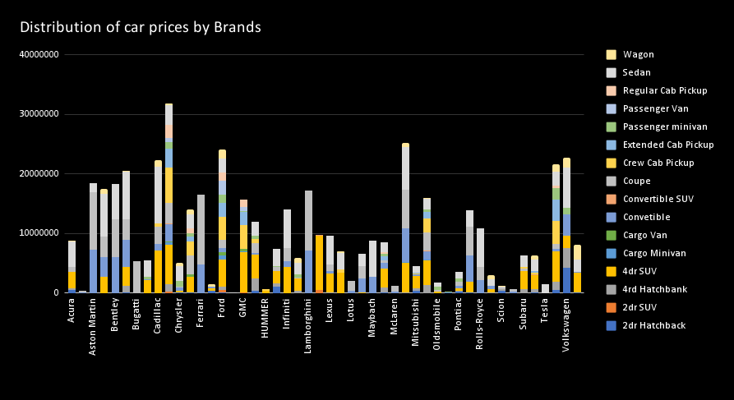
TASK - 1
How does the distribution of car prices vary by brand and body style?
Hints: Stacked column chart to show the distribution of car prices by brand and body style. Use filters and slicers to make the chart interactive. Calculate the total MSRP for each brand and body style using SUMIF or Pivot Tables.
CUSTOMERS

Slide 16
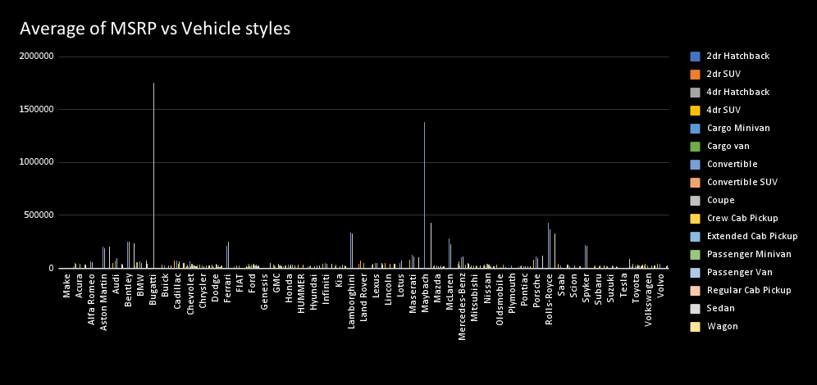
TASK - 2
Which car brands have the highest and lowest average MSRPs, and how does this vary by body style?
Hints: Clustered column chart to compare the average MSRPs across different car brands and body styles. Calculate the average MSRP for each brand and body style using AVERAGEIF or Pivot Tables.
CUSTOMERS

Slide 17
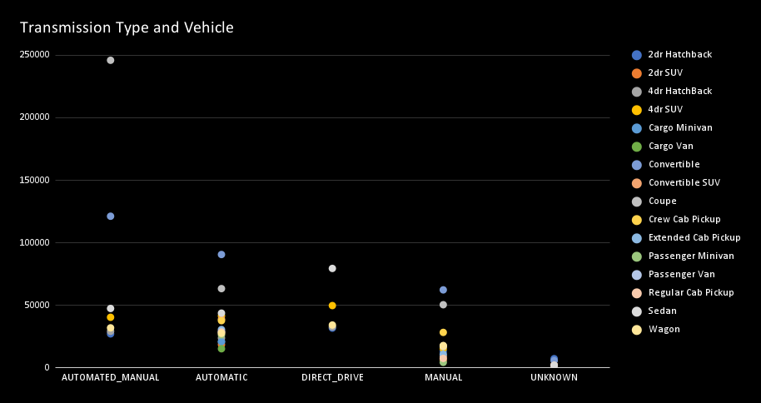
TASK - 3
How do the different feature such as transmission type affect the MSRP, and how does this vary by body style?
Hints: Scatter plot chart to visualize the relationship between MSRP and transmission type, with different symbols for each body style. Calculate the average MSRP for each combination of transmission type and body style using AVERAGEIFS or Pivot Tables.
CUSTOMERS

Slide 18
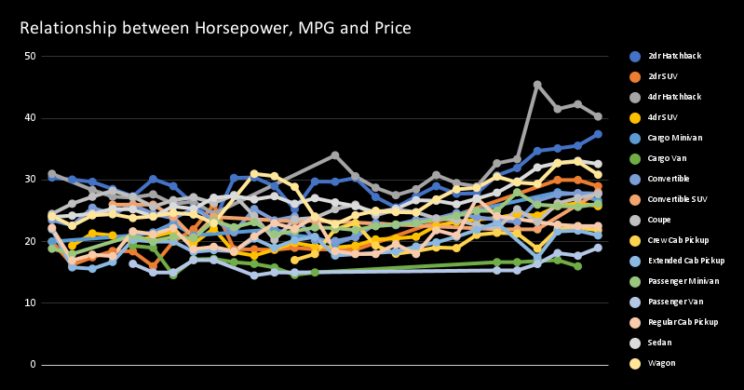
TASK - 4
How does the fuel efficiency of cars vary across different body styles and model years?
Hints: Line chart to show the trend of fuel efficiency (MPG) over time for each body style. Calculate the average MPG for each combination of body style and model year using AVERAGEIFS or Pivot Tables.
CUSTOMERS

Slide 19
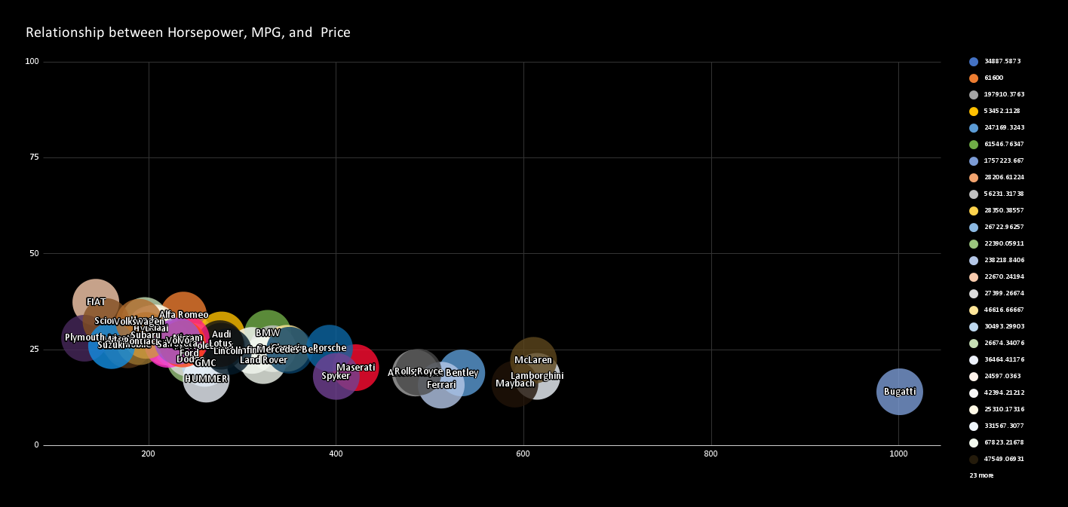
TASK - 5
How does the car's horsepower, MPG, and price vary across different Brands?
Hints: Bubble chart to visualize the relationship between horsepower, MPG, and price across different car brands. Assign different colors to each brand and label the bubbles with the car model name. Calculate the average horsepower, MPG, and MSRP for each car brand using AVERAGEIFS or Pivot Tables.
CUSTOMERS

Slide 20

CAR ANALYSIS DASHBOARD

Slide 21



STRATEGIES
As the dataset provided is about the real-time data so it may have null values or any disarrangement of data ,it’s very important to perform error handling and process the data for valid result..
Providing results to the clients problem should be accurate as it helps them in future design making and from the details the client can make decision to make a better profitability for car over time.
I have used the data analysis techniques such as regression and market segmentation in order to develop a dashboard that helps in providing interactive charts.
STRATEGY N°1
STRATEGY N°2
STRATEGY N°3

Slide 22

CONCLUSION
Through this project, I was able to understand the importance of Data Analytics in Car Feature Analysis as it provides valuable insights which helps in making Data-Driven Decisions.
In this project I was able to get insights like which features effects Car Price, relationship between Engine Cylinders and it’s fuel efficiency etc. I also got experience in Data Preprocessing like Data Cleaning, handling Outliers, Feature Engineering etc. in this project which can be communicated to relevant stakeholders as per the requirements.

Slide 23
LINKS
Analysis :
Features analysis
Dashboard :
Car_dashboard
Docs:
Impact of car analysis
Video :
DATASET
Explanation video
Ceo Of Ingoude Company

